Slide 1
Schema Refinement & Functional Dependencies
Session 05
Rico Halim, S.Kom., M.Kom.

Slide 2
Learning Outcomes
Session 5
At the end of this session, students will be able to:
LO 2: Explain the concepts of relational algebra, data manipulation language, and transaction management on database

Slide 3
outline
Session 5
The Problem of Redundancy & Anomalies
NULL Values & Spurious Tuples
Functional Dependencies
Types of Functional Dependencies
From Problem to Solution (Bridge to Normalization)

Slide 4
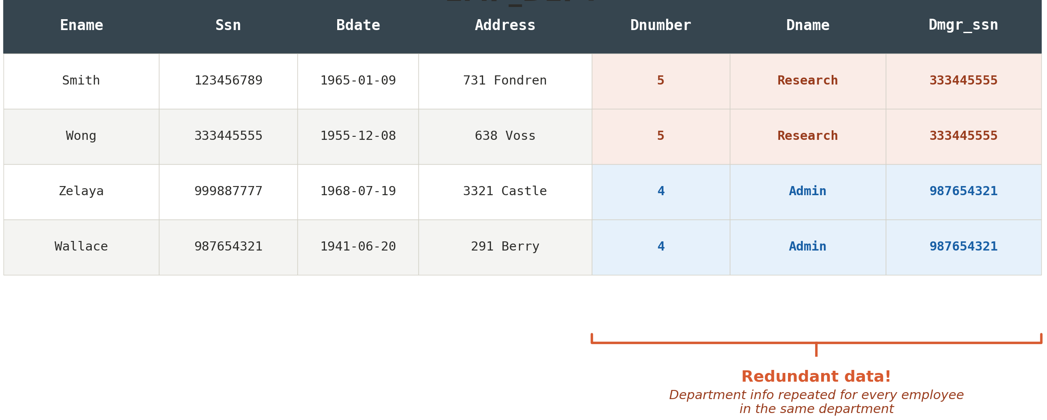
The Problem of Redundancy & Anomalies
Redundancy
Redundancy refers to the repetition of the same data across multiple rows in a relation
One major goal of schema design: minimize storage space and avoid data inconsistency
Grouping attributes into relation schemas has a significant effect on both

Slide 5
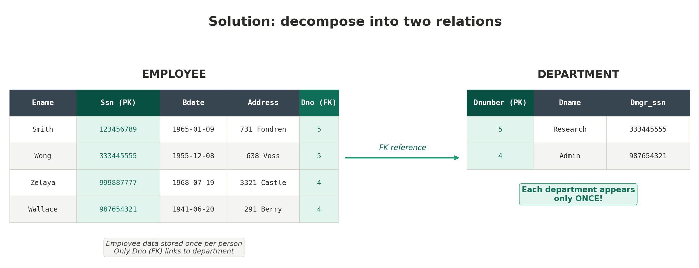
The Problem of Redundancy & Anomalies
Redundancy

Slide 6
The Problem of Redundancy & Anomalies
Anomalies
An additional problem caused by poor schema design
Anomalies = situations where data operations (INSERT, DELETE, UPDATE) cause undesirable results or inconsistencies
Three types:
  Insertion anomaly — cannot add new data without unrelated data
  Deletion anomaly — removing data causes unintended loss of other data
  Update anomaly — changing one fact requires updating many rows

Slide 7
The Problem of Redundancy & Anomalies
Insertion anomaly
Occurs when we cannot insert new data due to the table structure
Example: we want to add a new department "Marketing" that has no employees yet
But Ssn is the primary key — it cannot be NULL
Result: we cannot store department info without having at least one employee

Slide 8
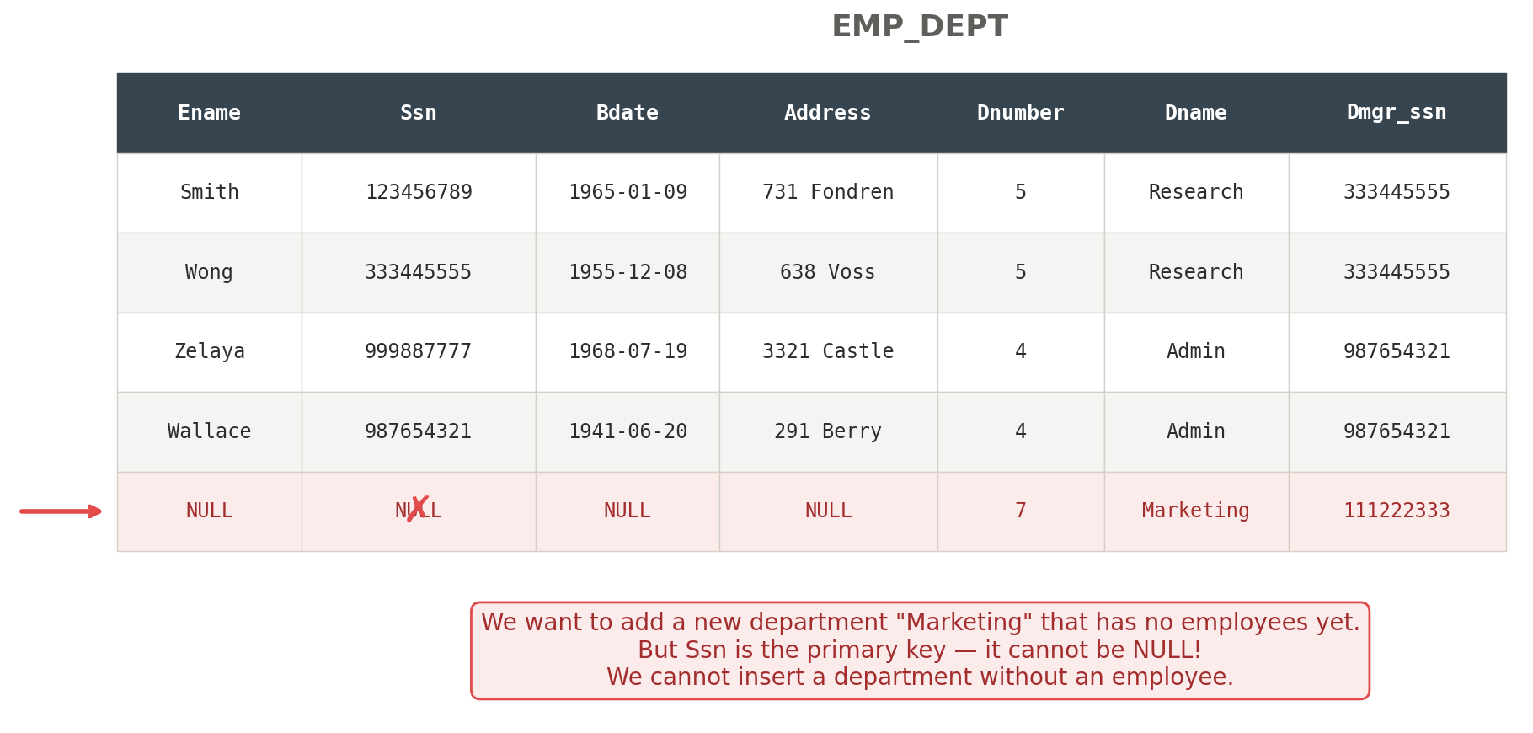
The Problem of Redundancy & Anomalies
Insertion anomaly

Slide 9
The Problem of Redundancy & Anomalies
Deletion anomaly
Occurs when deleting a row causes unintended loss of other data
Example: Zelaya is the last employee in Dept 4 "Admin"
If we delete Zelaya, all information about the Admin department is lost
The department still exists in real life, but the database has no record of it

Slide 10
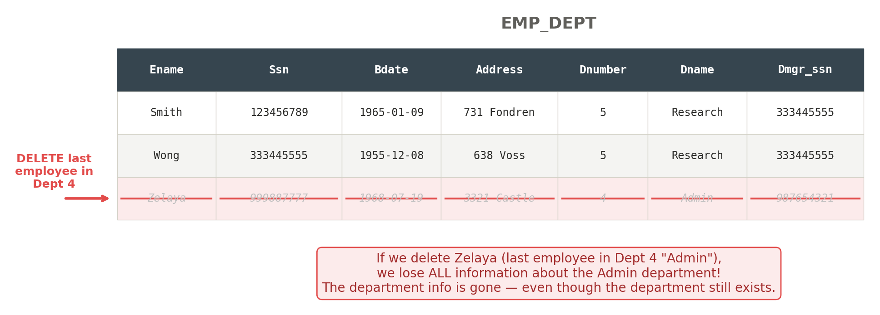
The Problem of Redundancy & Anomalies
Deletion anomaly

Slide 11
The Problem of Redundancy & Anomalies
Update anomaly
Occurs when updating a value requires changes in many places
Example: Dept 5 renamed from "Research" to "R&D"
We must update ALL rows where Dnumber = 5
If we miss even one row → database is inconsistent (same dept, two different names)

Slide 12
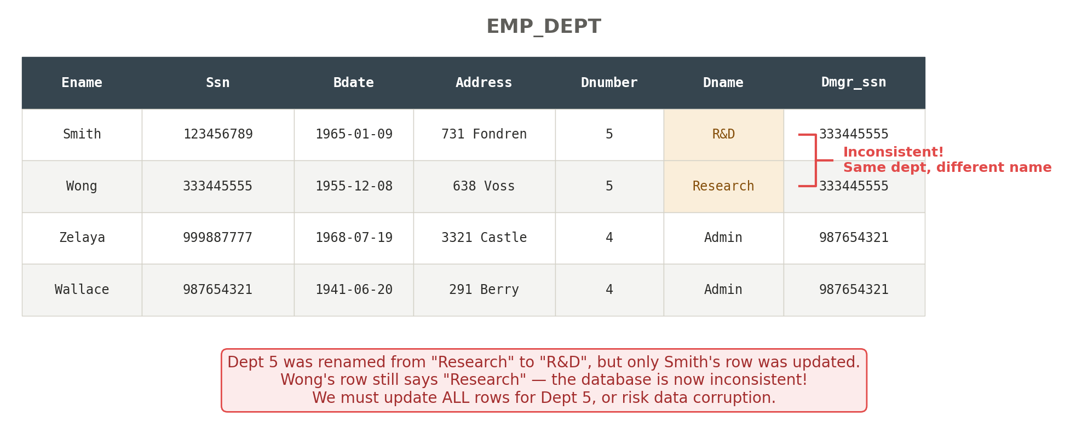
The Problem of Redundancy & Anomalies
Update anomaly

Slide 13
NULL Values & Spurious Tuples.
NULL Values
When we design a schema poorly (e.g., grouping too many attributes in one table), many attributes will have no meaningful value for certain rows → NULL
NULL has three possible interpretations:
  Not applicable — the attribute does not apply to this tuple (e.g., Visa_status for domestic students)
  Unknown — the value exists but we don't know it (e.g., Date_of_birth unknown)
  Not yet recorded — the value is known to exist but hasn't been entered yet (e.g., Home_Phone_Number)
NULLs cause problems in SELECT and JOIN because comparisons with NULL return UNKNOWN, not TRUE or FALSE

Slide 14
NULL Values & Spurious Tuples.
Spurious tuples
Spurious tuples = invalid/meaningless rows that appear in the result of a JOIN operation
This happens when we join two tables on attributes that are NOT a (primary key, foreign key) pair
Example: if we decompose EMP_DEPT incorrectly and later join on a non-key attribute like Dname or Address, the result may contain rows that never existed in the original data
Guideline: always join on properly related (PK, FK) pairs to guarantee no spurious tuples are generated

Slide 15
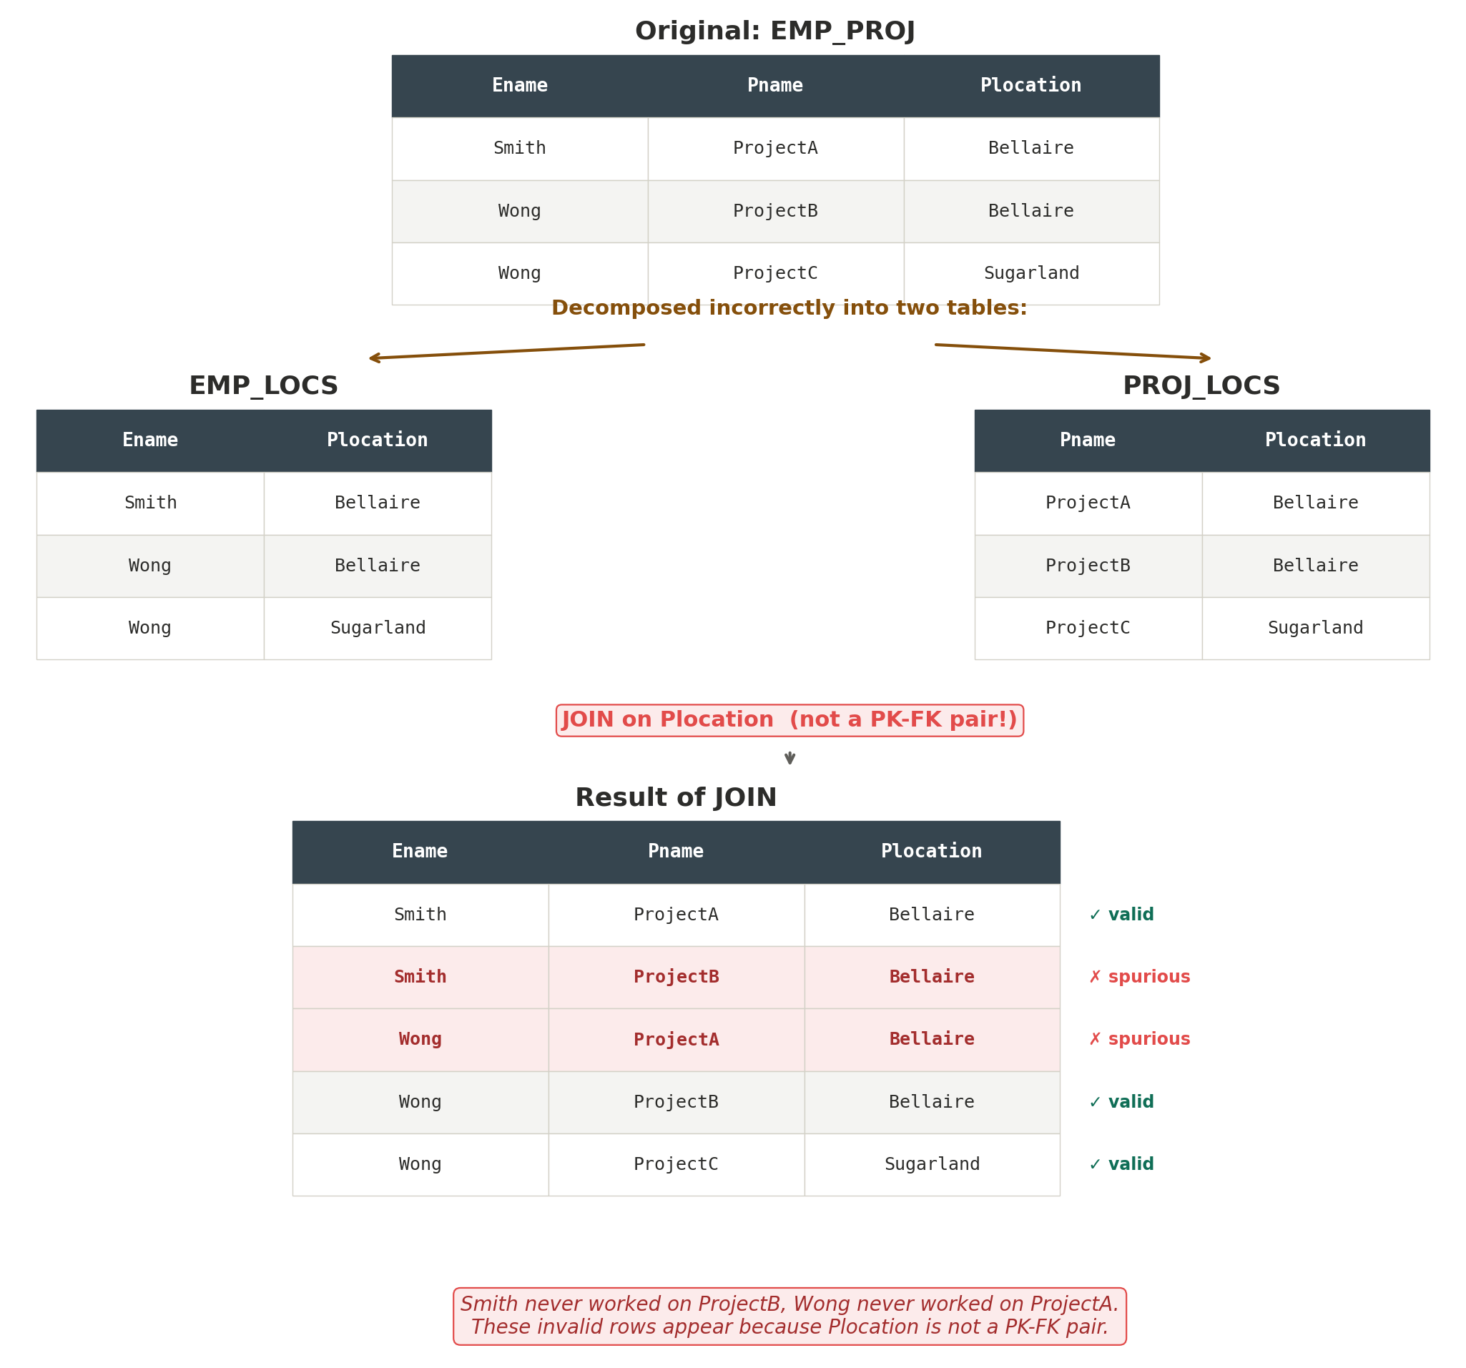
NULL Values & Spurious Tuples.
Spurious tuples

Slide 16
Functional Dependencies
What is a Functional Dependency?
A formal tool for analyzing relational schemas — helps us detect and describe problems like redundancy and anomalies
A functional dependency is denoted by X → Y (read: "X functionally determines Y")
Meaning: if two tuples have the same value of X, they must have the same value of Y
Example: Ssn → Ename — if two rows have the same Ssn, they must have the same Ename
X = left-hand side (determinant), Y = right-hand side (dependent)

Slide 17
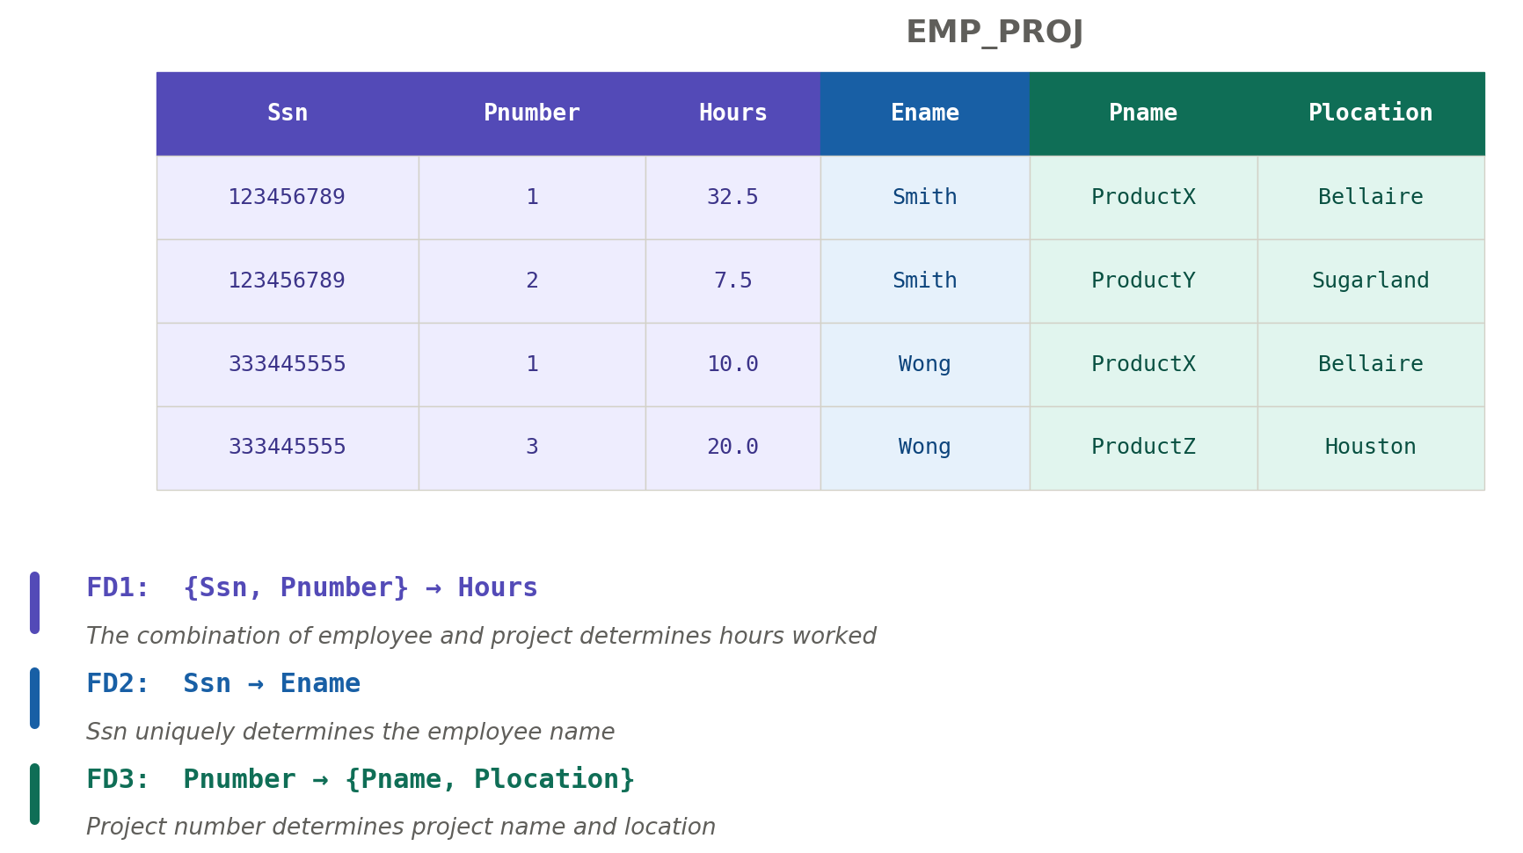
Functional Dependencies
What is a Functional Dependency?

Slide 18
Functional Dependencies
How to prove / disprove a functional dependency
FD cannot be confirmed just by looking at data — it must be defined by someone who knows the semantics (business rules) of the attributes
From data, we can only say "this FD may hold" if no violation is found
But we can disprove a FD — one counterexample is enough

Slide 19
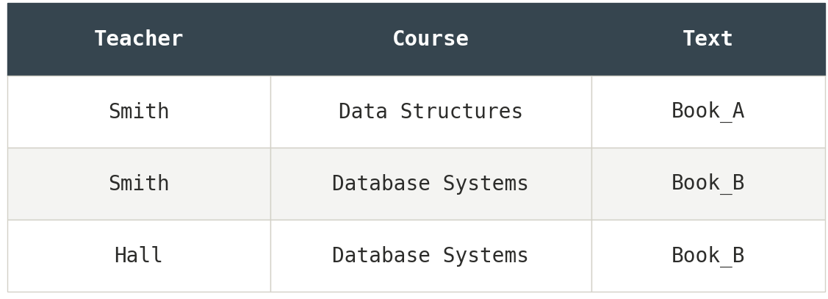
Functional Dependencies
How to prove / disprove a functional dependency
Example from TEACH table:
Can we say Teacher → Course? No — Smith teaches two different courses (counterexample found)
Can we say Course → Text? Maybe — no violation yet, but we can't be sure until we know the business rule

Slide 20
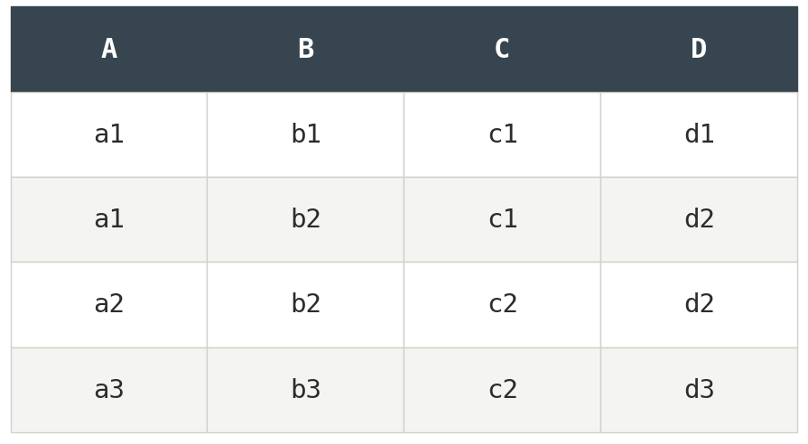
Functional Dependencies
Identifying FD from data
May hold (no violation found):
B → C
B → D
{A, B} → C
{A, B} → D
Does NOT hold (counterexample exists):
A → B — tuples 1 & 2 violate (same A, different B)
B → A — tuples 2 & 3 violate (same B, different A)
D → C — tuples 3 & 4 violate (same D... wait, d2 and d3 are different)

Slide 21
Types of Functional Dependencies
Full Functional Dependency
A functional dependency X → Y is full if removing any attribute from X causes the dependency to no longer hold
Example from EMP_PROJ:
  {Ssn, Pnumber} → Hours is a full FD
  Because neither Ssn → Hours nor Pnumber → Hours holds on its own
  You need both Ssn AND Pnumber to determine Hours

Slide 22
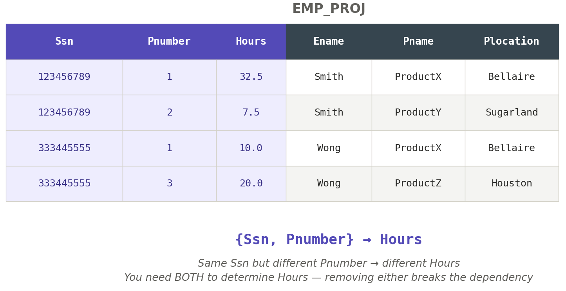
Types of Functional Dependencies
Full Functional Dependency

Slide 23
Types of Functional Dependencies
Partial dependency
A functional dependency X → Y is partial if some attribute can be removed from X and the dependency still holds
Example from EMP_PROJ:
  {Ssn, Pnumber} → Ename is partial
  Because Ssn → Ename already holds — Pnumber is not needed
  Partial dependencies cause redundancy (Ename repeated for every project)

Slide 24
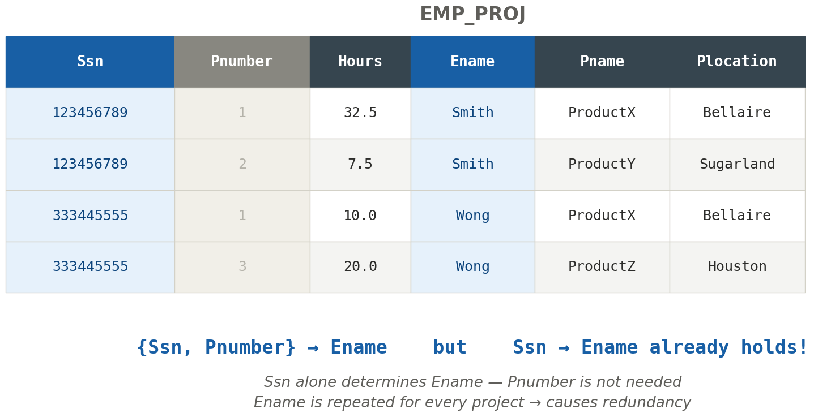
Types of Functional Dependencies
Partial dependency

Slide 25
Types of Functional Dependencies
Transitive dependency
A functional dependency X → Z is transitive if there exists Y such that X → Y and Y → Z both hold
The dependency from X to Z is indirect — it goes through Y
Example from EMP_DEPT:
  Ssn → Dmgr_ssn is transitive through Dnumber
  Because Ssn → Dnumber and Dnumber → Dmgr_ssn
  Transitive dependencies cause update anomalies

Slide 26
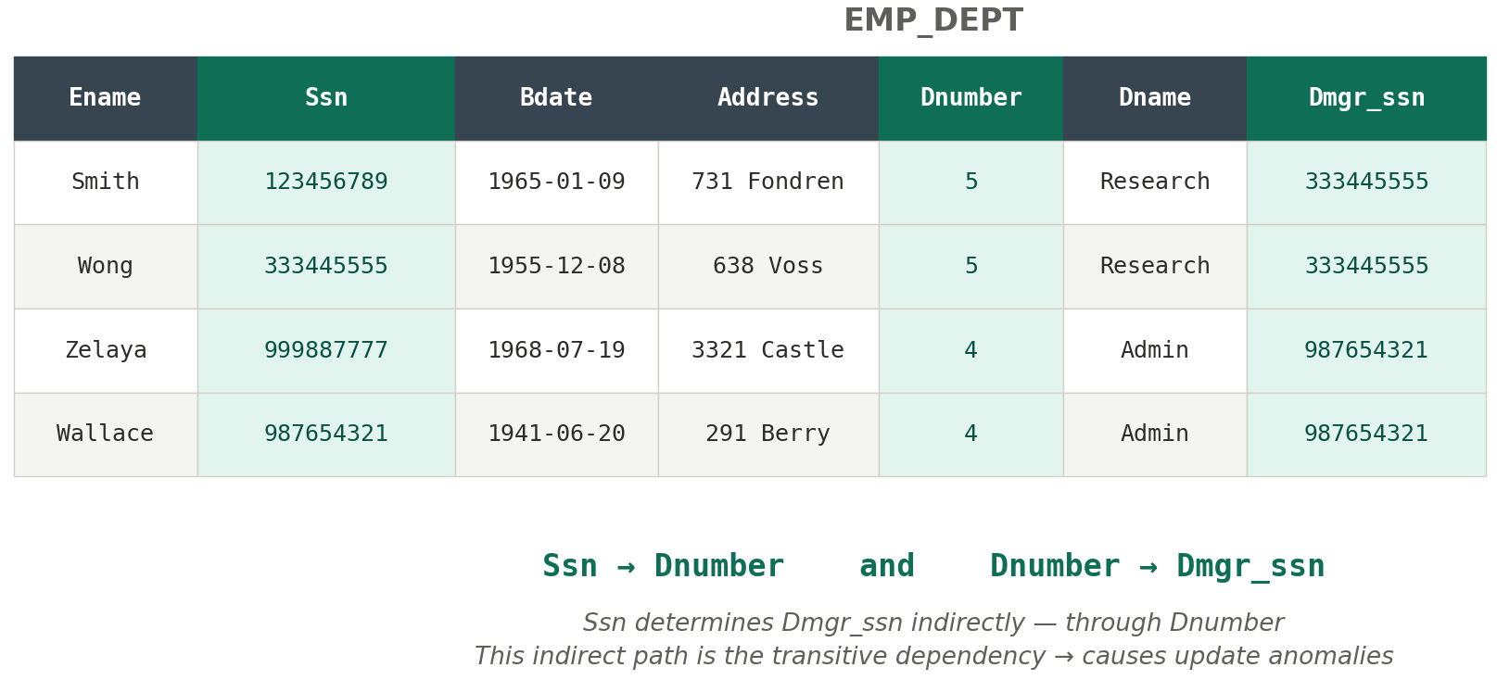
Types of Functional Dependencies
Transitive dependency

Slide 27
From Problem to Solution (Bridge to Normalization)
Poor schema design causes:
  Redundancy → wasted storage, data inconsistency
  Anomalies → insertion, deletion, update problems
  NULL values → unpredictable query results
  Spurious tuples → invalid data from bad joins
Functional dependencies are the tool to detect these problems:
  Partial FD → causes redundancy (same data repeated)
  Transitive FD → causes update anomalies (indirect dependencies)
The solution: Normalization — a systematic process to decompose tables by removing partial and transitive dependencies

Slide 28
Summary
The Problem of Redundancy & Anomalies — Redundancy causes insertion, deletion, and update anomalies. Poor schema design leads to data inconsistency.
NULL Values & Spurious Tuples — NULLs have three interpretations and cause unpredictable query results. Spurious tuples appear from joining on non PK-FK attributes.
Functional Dependencies — X → Y means X uniquely determines Y. One counterexample disproves an FD, but data alone cannot confirm one.
Types of FD — Full: all attributes needed. Partial: some removable → causes redundancy. Transitive: indirect path X → Y → Z → causes anomalies.
From Problem to Solution — FDs detect schema problems. Normalization (Session 6) fixes them systematically.

Slide 29
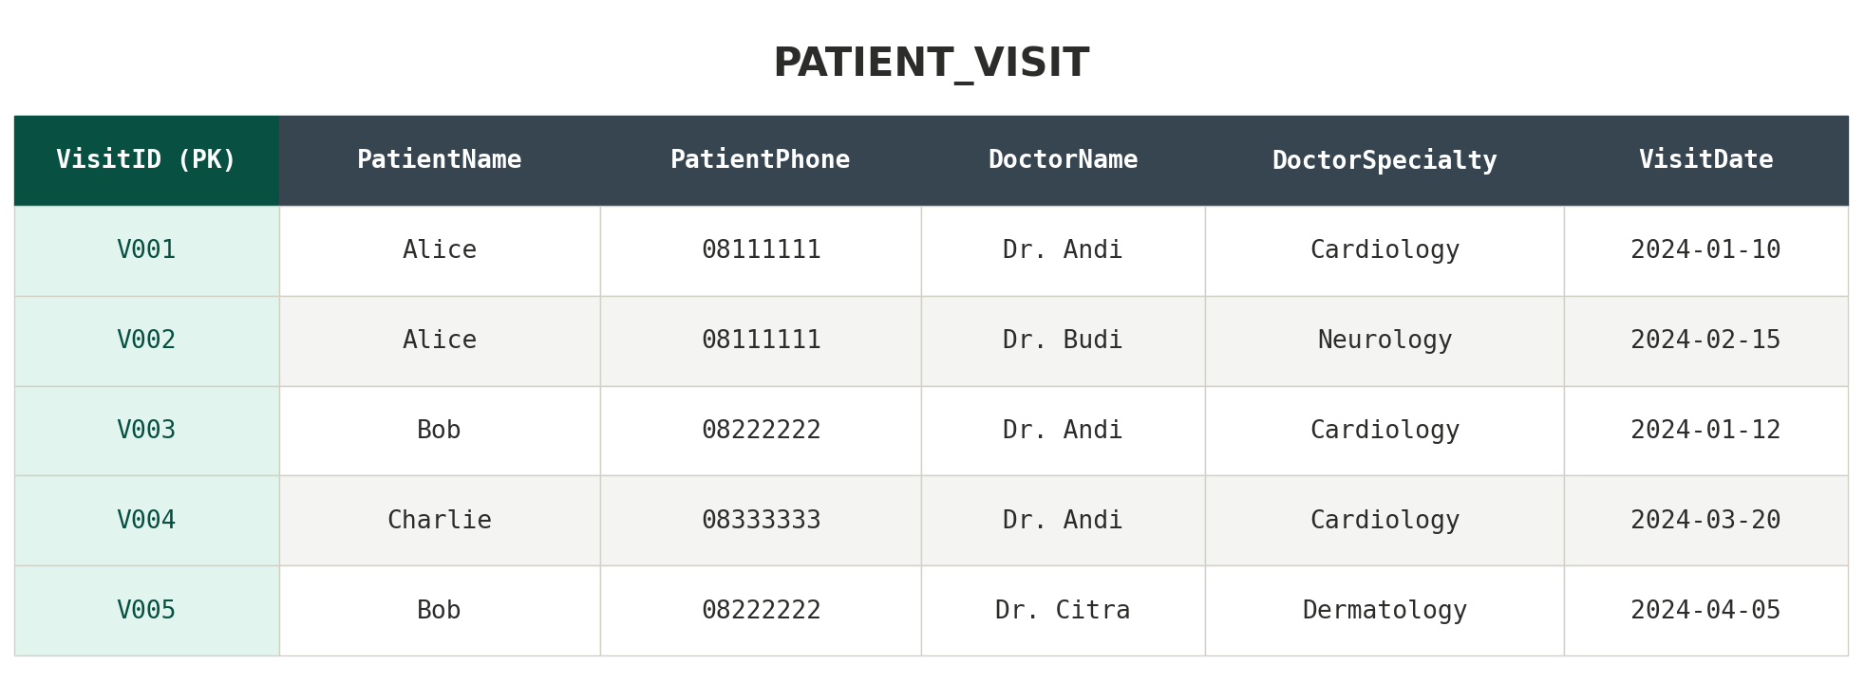
exercise

Slide 30
exercise
Identify the functional dependencies that hold in this table. List at least 3 FDs.
Classify each FD you found as Full, Partial, or Transitive dependency. Explain why.
Identify the anomalies in this table:
  Give an example of an insertion anomaly
  Give an example of a deletion anomaly
  Give an example of an update anomaly
Propose a solution: how would you decompose this table to eliminate the redundancy? (Hint: what separate tables would you create?)

Slide 31
References
Session 5
Elmasri, R. & Navathe, S. (2015). Fundamentals of Database Systems, 7th Edition. Pearson. Chapter 14.
Murach, J. (2023). Murach's MySQL, 4th Edition. Mike Murach & Associates. Chapter 10.

